Slide 1





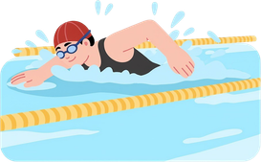
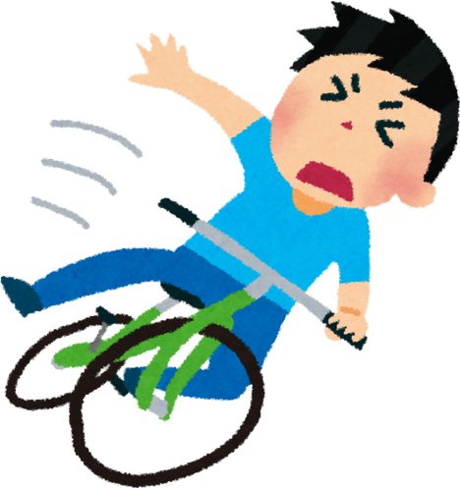
TEST
Fluentlearners.com School
...................
Semester 2
Timing: 1 hour
20
Name: ...................................................................................................... Class: ......../........
Number: ............
COMPREHENSION
Name: Yassine Grade: Middle School Year 2
I love sports! I can play soccer, basketball, and volleyball. I play soccer with my friends after school. On Fridays, I play basketball in the park. I also play volleyball at school. I can’t play rugby, but I want to try it one day. I also like music and languages. I speak Arabic and English. I want to learn Spanish because I like Spanish songs. In my free time, I listen to music and take a walk with my brother. I don’t like to do crafts, but I like to draw sometimes. After school, I go to clubs. I like to be active and learn new things.
Clubs:
Soccer Club (Monday – 4:00 PM)
Language Club (Saturday – 2:00 PM)
1. Write (True) or (False). (1.5 pt.)
3. Answer the following questions. (3 pts.)
  Yassine can play rugby. (.......................)
  He plays soccer on Friday. (.......................)
  He goes to a language club on Saturday. (.......................)
  What sports does Yassine play?
..........................................................................................................
  Who does he play soccer with?
..........................................................................................................
  When does he play basketball?
..........................................................................................................
2. Choose the correct option. (1 pt.)
  In his free time, Yassine likes to (do crafts - take a walk)
  He wants to learn Spanish because he likes (songs - school)
LANGUAGE
1. Circle the correct word. (2 pts.)
5. Put the sentences in order. (3 pts.)
  (Do / Does) your sister like to dance?
  I (don’t / doesn’t) like to swim.
  (Do / Does) they like to listen to music?
➝ Yes, they (do / don’t)
  I play with my friends from school. (...................)
  Me too! Where do you play? (...................)
  Yes, I do. I like to play basketball after school. (...................)
  I play in the park near my house. (...................)
  Do you like sports? (...................)
  Who do you play with? (...................)
2. Complete with “play - do” (1.5 pt.)
  I ....................................... football.
  I ....................................... crafts.
  I ....................................... chess.
3. Circle the correct response for each statement. (1 pt.)
WRITING
  I like to read books.
➝ Me too. / I don’t either.
  I don’t like to play tennis.
➝ I don’t. / I don’t either.
Complete this paragraph about your friend. (5 pts.)
Use this frame: My friend’s name is ... He/She is ... years old. He/she likes ... He/She doesn’t like ... He/She can/can’t ... He/She likes to watch ...
............................................................................................................................. ..................................................................................................................................
..................................................................................................................................
....................................................................................................................................................................................................................................................................
..................................................................................................................................
..................................................................................................................................
..................................................................................................................................
4. Look at the pictures and write sentences using “can” can’t”. (2 pts.)
  ...................................................
  ...................................................

Slide 2
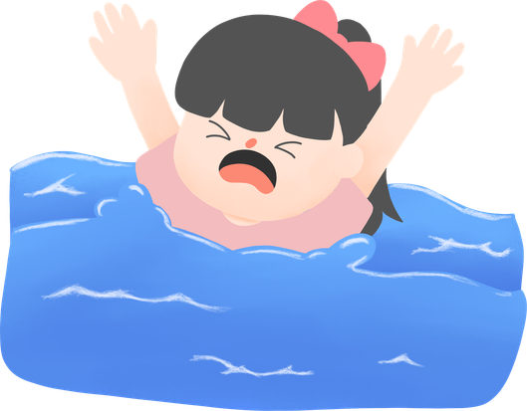
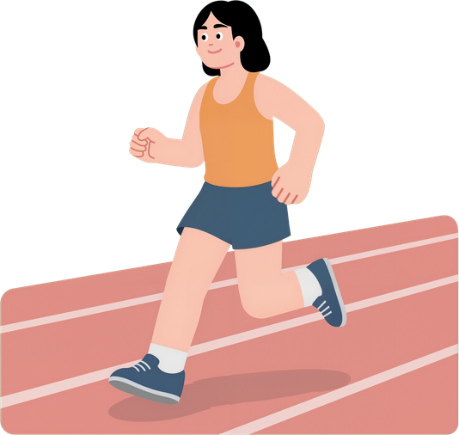
TEST
Fluentlearners.com School
...................
Semester 2
Timing: 1 hour
20
Name: ...................................................................................................... Class: ......../........
Number: ............
COMPREHENSION
Name: Salma Grade: Middle School Year 2
I love free-time activities and sports! I can play tennis, handball, and volleyball. I play handball with my classmates after school. On Saturdays, I play tennis in the sports club. I also play volleyball at school. I can’t swim, but I want to learn one day. I also like music and languages. I speak Arabic and French. I want to learn English because I like English movies. In my free time, I listen to music and ride my bike with my sister. I don’t like to play chess, but I like to paint sometimes. After school, I go to clubs. I like to meet new friends and learn new things.
Clubs:
Handball Club (Tuesday – 5:00 PM)
Music Club (Friday – 3:00 PM)
1. Write (True) or (False). (1.5 pt.)
3. Answer the following questions. (3 pts.)
  Salma can play volleyball. (.......................)
  She plays handball after school. (.......................)
  She goes to a music club on Tuesday. (.......................)
  What sports does Salma play?
..........................................................................................................
  Who does she play handball with?
..........................................................................................................
  When does she play tennis?
..........................................................................................................
2. Choose the correct option. (1 pt.)
  In her free time, Salma likes to (ride her bike - take a walk)
  She wants to learn English because she likes (songs - movies)
LANGUAGE
1. Circle the correct word. (2 pts.)
5. Put the sentences in order. (3 pts.)
  I (don’t / doesn’t) like to swim.
  (Do / Does) you like to play soccer?
  (Do / Does) your friend like to listen to music?
➝ No, he (does / doesn’t)
  I play at the sports club near my house. (...................)
  Really? Where do you play volleyball? (...................)
  Yes, I do. I like to play volleyball. (...................)
  I go with my cousin after school. (...................)
  Who do you go with? (...................)
  Do you like sports? (...................)
2. Complete with “play - do” (1.5 pt.)
  I ....................................... karate.
  I ....................................... volleyball.
  I ....................................... gymnastics.
3. Circle the correct response for each statement. (1 pt.)
WRITING
  I don’t like to watch tv.
➝ I don’t. / I don’t either.
  I like to play tennis.
➝ I don’t. / I don’t either.
Complete this paragraph about your friend. (5 pts.)
Use this frame: My friend’s name is ... He/She is ... years old. He/she likes ... He/She doesn’t like ... He/She can/can’t ... He/She likes to watch ...
............................................................................................................................. ..................................................................................................................................
..................................................................................................................................
....................................................................................................................................................................................................................................................................
..................................................................................................................................
..................................................................................................................................
..................................................................................................................................
4. Look at the pictures and write sentences using “can” ”can’t”. (2 pts.)
  ...................................................
  ...................................................

