Slide 1


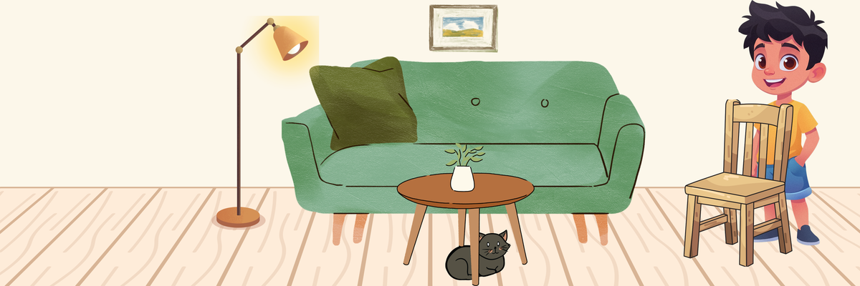
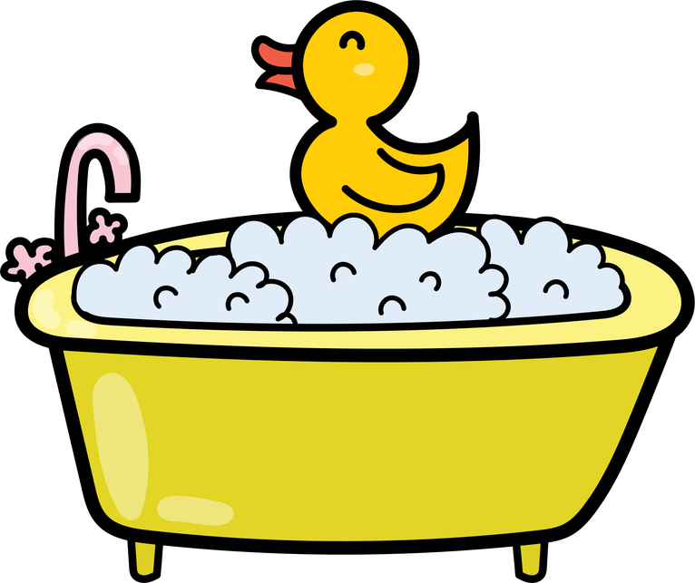



TEST
Fluentlearners.com School
...................
Semester 2
Timing: 1 hour
20
Name: ...................................................................................................... Class: ......../........
Number: ............
COMPREHENSION
My name is Malak. I am a student. On weekdays, I wake up at 6:30 in the morning. I wash my face and brush my teeth before I eat my breakfast. I usually eat bread and drink tea with my family. School starts at 8:00. I have many lessons like English and Math. I eat lunch at noon in the school canteen. Then, I go home at 3:30 in the afternoon. After I get home, I have a snack. I usually eat an apple. Then, I play video games on my computer for thirty minutes. After I relax, I do my chores. I always sweep the floor and set the table. I have basketball club at 6:00 in the evening. After basketball, I walk home and eat a big dinner with my parents. After dinner, I do my homework in my bedroom. Then, I go to bed at 10:00.
1. Tick the correct option. (1 pt.)
3. Answer the following questions. (2 pts.)
  Malak wakes up at six thirty.
☐ True ☐ False
  She washes her face after breakfast.
☐ True ☐ False
  What does Malak do after dinner?
..........................................................................................................
  What time does she go to bed?
..........................................................................................................
2. Choose the correct option. (1 pt.)
4. Complete with information from the text. (2 pts.)
  Malak has lunch at (12:00 - 3:30)
  She eats (bread - an apple) as a snack.
  Malak ........................................................... after she relaxes.
  She has a big ........................................................... after basketball.
LANGUAGE
1. Circle the correct option. (1.5 pts.)
  I ( What - How many - Where ) bedrooms are in your house?
➝ (There are - There is) two bedrooms.
  (What - Where - Who) is in the kitchen?
➝ Sara is in the kitchen.
5. Match. (2 pts.)
2. Complete with the correct adverb of frequency: “always - sometimes - never - usually” (1 pt.)
a
b
c
d
  He ....................................... does his homework in the kitchen. (0 %)
  We ....................................... revise our lessons. (100%)
  I take out the trash. (.........)
  I do the laundry. (.........)
  I walk the dog. (.........)
  I take a bath. (.........)
6. Complete the exchange. (2 pts.)
3. Put the verbs in the present continuous. (2 pts.)
  ...................................................................................................................?
➝ I go home at 5:30.
  ....................................................................... to hang out?
➝ Sorry, I can’t.
  What ................................. you ................................. (do)?
➝ I ....................................................... (watch) a video.
  What ................................. Amine ................................. (do)?
➝ He ....................................................... (read) a book.
WRITING
4. Look at the picture and complete the sentences.
Use: on - in - under - next to - above (1.5 pts.)
Complete this paragraph about your house. (4 pts.)
Hello. My name is ....................................... I am from ......................... I live in .................................................. (a house/an apartment) . It is ............................... (big/small). It has ..................... rooms. There are
..................................................................................................................................
..................................................................................................................................
  The lamp is ........................................ the sofa.
  The painting is ........................................ the sofa.
  The cat is ........................................ the table.

Slide 2

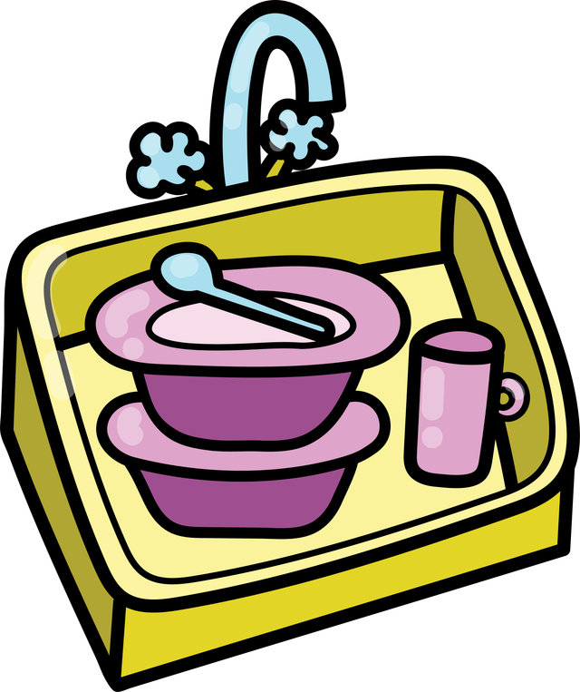

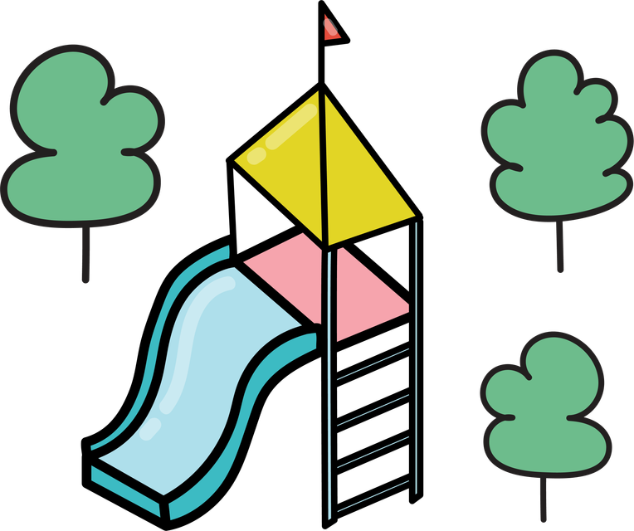
TEST
Fluentlearners.com School
...................
Semester 2
Timing: 1 hour
20
Name: ...................................................................................................... Class: ......../........
Number: ............
COMPREHENSION
My name is Karim. I am a student. On weekdays, I wake up at 7:00 in the morning. I wash my face and brush my teeth before I eat my breakfast. I usually eat bread and drink tea with my family. School starts at 8:00. I have many lessons like English and Math. I eat lunch at 12:00 in the school canteen. Then, I go home at 3:30 in the afternoon. After I get home, I have a snack. I usually eat an apple. Then, I play video games on my computer for thirty minutes. After I relax, I clean my room. I always make my bed. I have basketball club at 6:00 in the evening. After basketball, I walk home and eat a big dinner with my parents. After dinner, I revise my lessons in my bedroom. Then, I go to bed at 11:00.
1. Tick the correct option. (1 pt.)
3. Answer the following questions. (2 pts.)
  Karim wakes up at six thirty.
☐ True ☐ False
  He washes his face before breakfast.
☐ True ☐ False
  What does Karim do after dinner?
..........................................................................................................
  What time does he go to bed?
..........................................................................................................
2. Choose the correct option. (1 pt.)
4. Complete with information from the text. (2 pts.)
  Karim has lunch at (midnight - noon)
  He eats (bread - an apple) for breakfast.
  Karim ........................................................... after he relaxes.
  He has ........................................................... in the school canteen.
LANGUAGE
1. Circle the correct option. (1.5 pts.)
  I ( What - How many - Where ) kitchens are in your house?
➝ (There are - There is) one kitchen.
  (What - Where - Who) is Sara?
➝ She is in the living room.
5. Match. (2 pts.)
2. Complete with the correct adverb of frequency: “always - sometimes - never - usually” (1 pt.)
a
b
c
d
  He ....................................... does his homework in the kitchen. (75 %)
  We ....................................... play football. (50%)
  I take a shower. (.........)
  I do the dishes. (.........)
  I brush my teeth. (.........)
  I go to the park. (.........)
6. Complete the exchange. (2 pts.)
3. Put the verbs in the present continuous. (2 pts.)
  ...................................................................................................................?
➝ I go to school at 7:30.
  ....................................................................... hang out!
➝ Sorry, I can’t.
  What ................................. Sara ................................. (do)?
➝ She ....................................................... (watch) a video.
  What ................................. they ................................. (do)?
➝ They ....................................................... (read) a book.
WRITING
4. Look at the picture and complete the sentences.
Use: under - in front of - behind - next to - on (1.5 pts.)
Complete this paragraph about your house. (4 pts.)
Hello. My name is ....................................... I am from ......................... I live in .................................................. (a house/an apartment) . It is ............................... (big/small). It has ..................... rooms. There are
..................................................................................................................................
..................................................................................................................................
  The vase is ........................................ the table.
  The table is ........................................ the sofa.
  The boy is ........................................ the chair.

