Slide 1


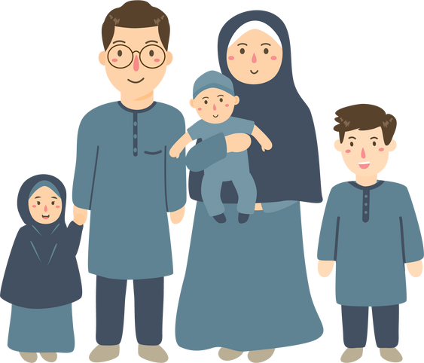



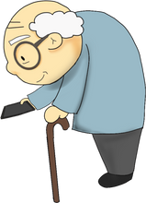


SEMESTER 1 QUIZ 1
A
............................... MIDDLE SCHOOL
STUDENT’S INFO
Name: ..........................................................................................
Class: ........../..........
Number: ..........
Mark: ............................/10
VOCABULARY (5 PTS.)
1. Complete with the missing days of the week. (1 pt.)
2. Write these numbers in words. (1 pt.)
Sunday - ................................ - Tuesday - ................................
1 : ................................ - 17: ................................
3. Match the countries with the flags. (1 pt.)
4. Complete with family members. (1 pt.)
...............
  Japan
  Spain
...............
Me
5. Match the following words with the pictures: read - old - write (1 pt.)
.............................
...............................
GRAMMAR (3 PTS.)
1. Circle the correct option. (2 pts.)
a) She (am - is - are) my sister.
c) I (am - is - are) a student.
b) He (‘m - ‘s - ‘re) 14.
d) This my friend. (My - His - Her) name is Ali.
2. Complete the answers. (1 pt.)
a) Do you have a sister?
Yes, I ...............
b) Is she a student?
No, she ...............
COMMUNICATION (2 PTS.)
Complete the dialogue. (2 pts.)
Amine: Hi, How are you?
Aya: I .............................................................., thanks.
Amine: ......................................................................... ?
Aya: My name is Aya.
Amine: ...................................................................... it?
Aya: It’s A-Y-A
Amine: ..................................................................... ?
Aya: I am thirteen years old.
Amine: Nice to meet you.
Aya: Nice to meet you, too.

Slide 2



SEMESTER 1 QUIZ 1
B
............................... MIDDLE SCHOOL
STUDENT’S INFO
Name: ..........................................................................................
Class: ........../..........
Number: ..........
Mark: ............................/10
VOCABULARY (5 PTS.)
1. Complete with the missing days of the week. (1 pt.)
2. Write these numbers in words. (1 pt.)
Thursday - ................................ - Saturday - ................................
2 : ................................ - 19: ................................
3. Match the countries with the flags. (1 pt.)
4. Complete with family members. (1 pt.)
...............
  UK
  USA
Me
...............
5. Match the following words with the pictures: read - thin - big (1 pt.)
.............................
...............................
GRAMMAR (3 PTS.)
1. Circle the correct option. (2 pts.)
a) I (am - is - are) 13.
c) She (‘m - ‘s - ‘re) a student.
b) He (am - is - are) 14.
d) This my friend. (My - His - Her) name is Aya.
2. Complete the answers. (1 pt.)
a) Do you have a sister?
No, I ...............
b) Is she a student?
Yes, she ...............
COMMUNICATION (2 PTS.)
Complete the dialogue. (2 pts.)
Aya: Hello, how are you?
Amine: I ......................................................., thanks.
Aya: ............................................................................... ?
Amine: I am from Morocco.
Aya: ................................................................................?
Amine: My name is Amine.
Aya: ..................................................................... it ?
Amine: It’s A-M-I-N-E.
Aya: Nice to meet you.
Amine: Nice to meet you, too.

